Slide 1
Attendance Analytics & Student Engagement
Identifying Engagement Patterns & At-Risk Students
By: Taiye Michaels
March , 2026

Slide 2
Problem Statement
Virtual learning environments lack visibility into student engagement
Instructors struggle to identify disengaged or at-risk students early
Attendance alone does not fully capture participation quality
By: Taiye Michaels

Slide 3
Project Objectives
Analyze attendance behavior
Identify engagement patterns
Flag at-risk students for early intervention
By: Taiye Michaels

Slide 4
Dataset Overview
Source: Behavior-driven synthetic dataset
Records: 11,000+ attendance logs
Students: 300
Sessions: 50–60
Includes realistic patterns (late joins, early exits, missing values)
Features: Session_id, student_id, joined_at, left_at, engagement_level, session_duration, day_of_week and hour
By: Taiye Michaels

Slide 5
Methodology
1. Data Preparation
Cleaned missing and invalid records
Converted datetime fields
Created session duration, day of week and hour features
2. Feature Engineering
Attendance rate
Average session duration
Total sessions attended
Most active day
By: Taiye Michaels

Slide 6

Methodology (Cont.)
3. Analysis
Time-based trends
Student engagement patterns
4. Modeling
Rule-based At-Risk classification

Slide 7
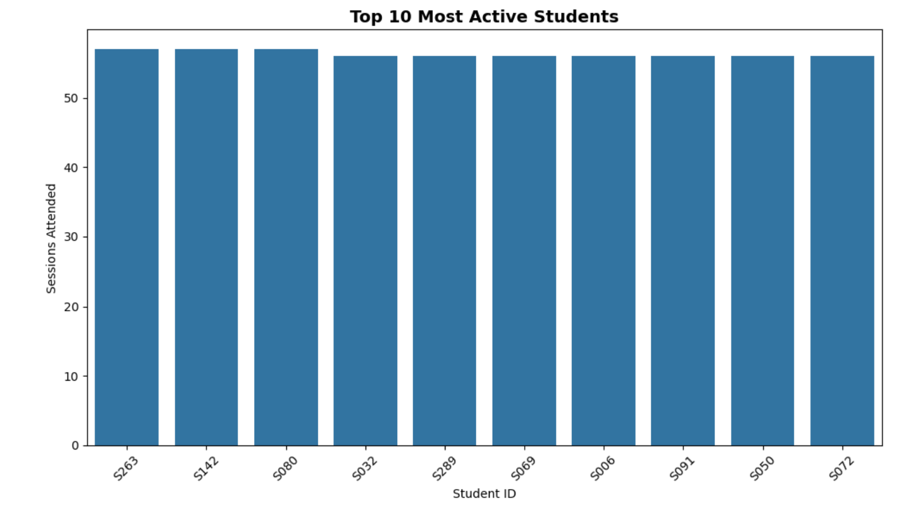
Key Visualizations
Top 10 most active students

Slide 8
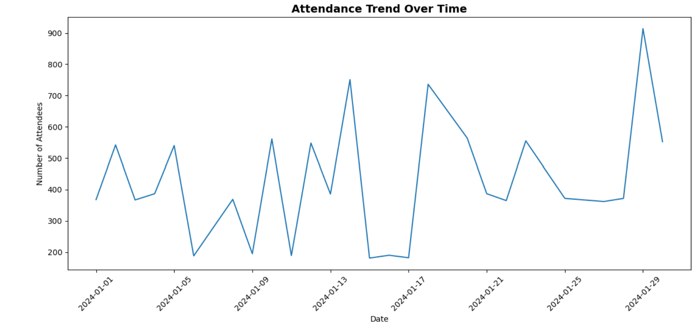
Key Visualizations (Cont.)
Attendance trend over time

Slide 9
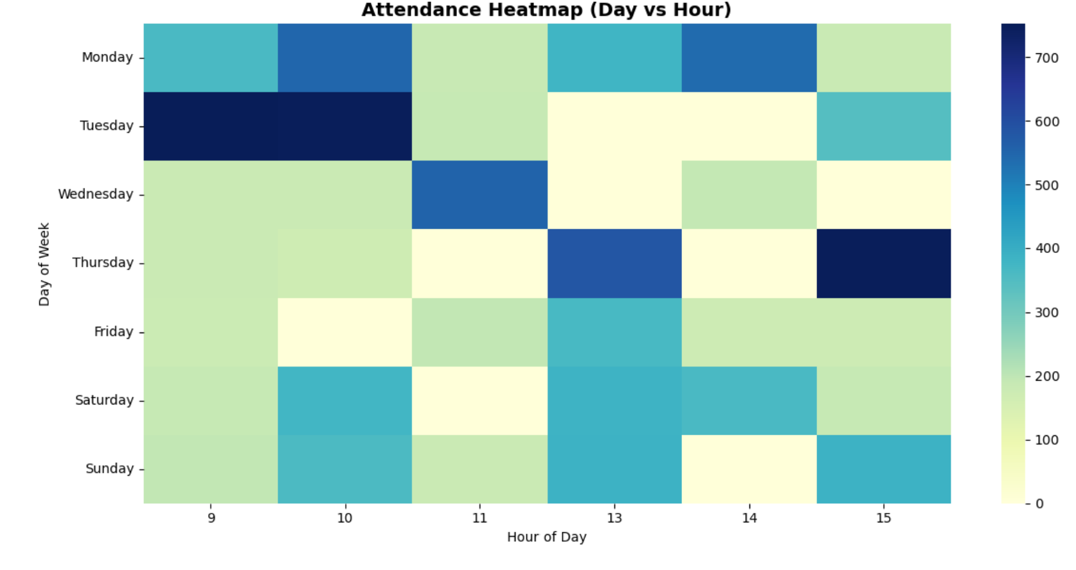
Key Visualizations (Cont.)
Day vs Hour of engagement

Slide 10
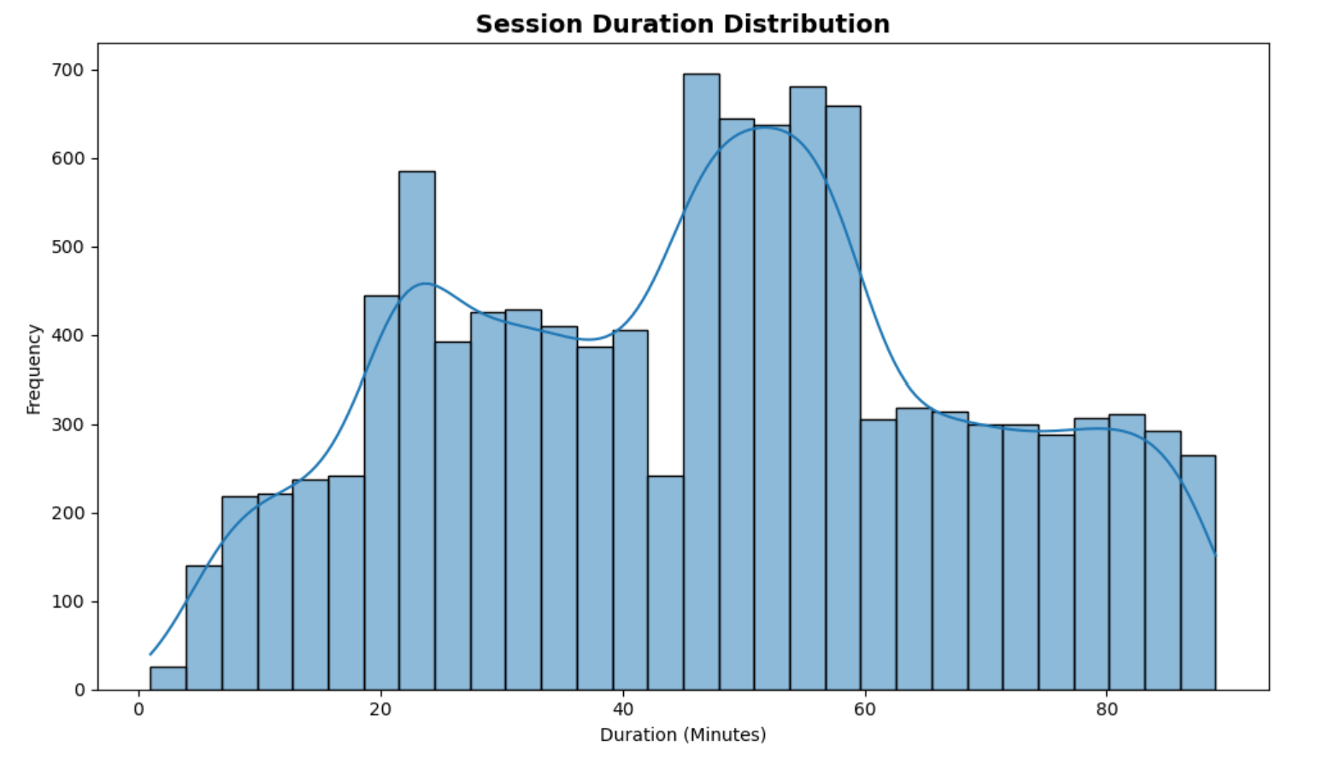
Key Visualizations (Cont.)
Session duration distribution

Slide 11
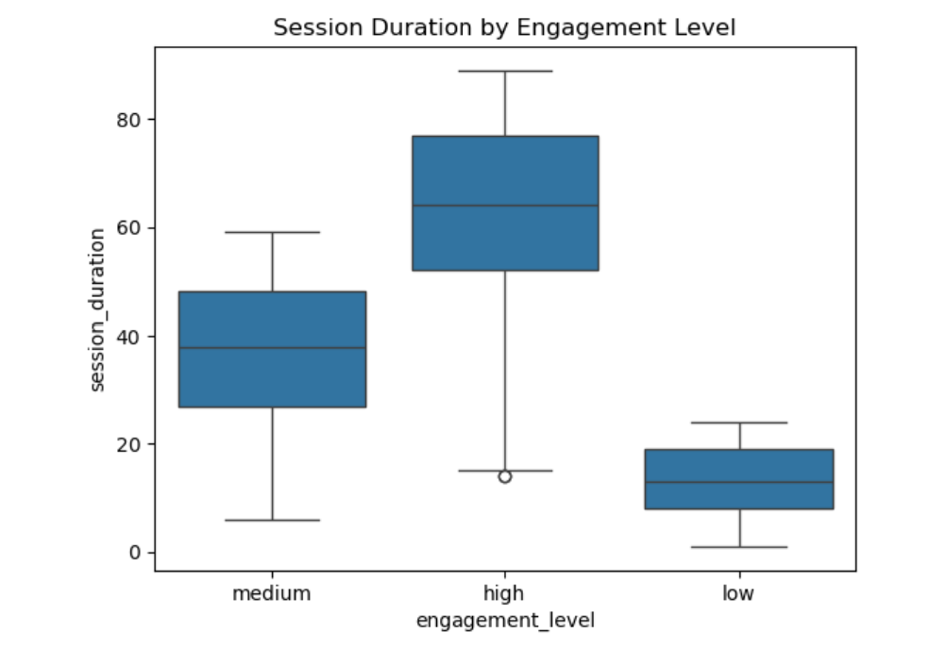
Key Visualizations (Cont.)
Session duration by engagement level

Slide 12
At-Risk Model
Approach: Rule-based classification
Criteria:
When attendance rate < 50%
OR average session duration < 20 minutes
Output:
Binary classification: 0 → Active
1 → At-Risk
Value:
Simple, interpretable and actionable

Slide 13
Key Insights
A small group of students consistently attends the highest number of sessions.
Peaks suggest participants’ high-interest sessions or favourable timing.
Attendance is concentrated during 9am till 3pm, this appears to be the peak participation time.
Weekdays witnessed higher rates of engagement as compared to weekends.
The most engaging sessions falls within 50 - 75 minutes.
The least engaging sessions falls below 20mins.

Slide 14
Recommendations
Monitor students with consistently short durations.
Schedule key sessions during peak engagement hours i.e. 9am till 10am on Tuesdays and 3pm on Thursdays.
Improve interactivity to reduce early drop-offs.
Avoid low-engagement time slots.
Reassess low engaging sessions for a content curriculum versus intended audience fit.

Slide 15
Thank You !

